Slide 1
CSE 209 Computer Architecture Design of an ALU
Saem Hasan
Lecturer
CSE, BUET

Slide 2
ALU and the Processor
ALU stands for Arithmetic Logic Unit
A part of the processor or CPU

Slide 3












Some Terminologies Revisiting
Decoder, Encoder
2X4
Decoder
$$Y_{0}$$
$$X_{0}$$
4X2
Encoder
$$X_{0}$$
$$Y_{1}$$
$$X_{1}$$
$$Y_{0}$$
$$X_{1}$$
$$Y_{2}$$
$$X_{2}$$
$$Y_{1}$$
$$Y_{3}$$
$$X_{3}$$
E
E

Slide 4






Some Terminologies Revisiting
DeMUX, MUX
1X4
DeMUX
$$Y_{0}$$
$$X_{0}$$
4X1
MUX
$$Y_{1}$$
$$X_{1}$$
$$X_{0}$$
$$Y_{0}$$
$$Y_{2}$$
$$X_{2}$$
$$Y_{3}$$
$$X_{3}$$
$$S_{1}$$
$$S_{0}$$
$$S_{1}$$
$$S_{0}$$

Slide 5
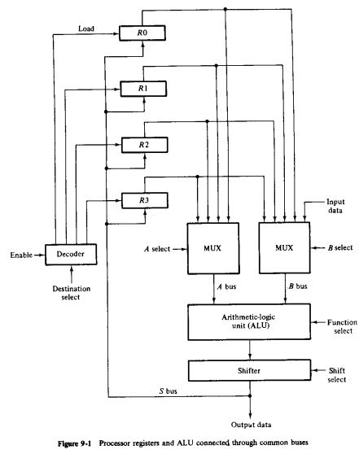
A Simplified Processor in Operation
$$R_{1}←R_{2}+R_{3}$$
0000 0001 0010 0011

Slide 6
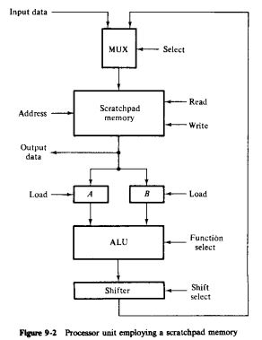

Simplified Processor with Scratchpad Memory
$$R_{1}←R_{2}+R_{3}$$

Slide 7
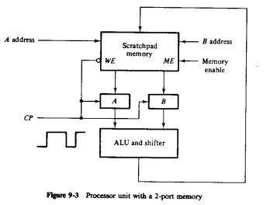
Simplified Processor with Scratchpad Memory
$$R_{1}←R_{2}+R_{3}$$

Slide 8
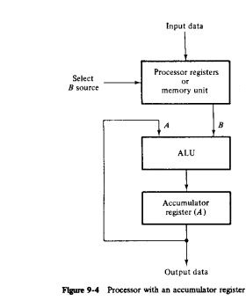

Simplified Processor with Accumulator
$$R_{1}←R_{2}+R_{3}$$

Slide 9
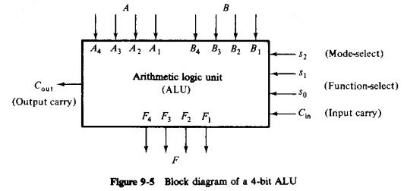
An ALU Unit
Can perform both Arithmetic and Logic Operations
Arithmetic/Logical Operation
Which Operation/Function
Helps Function-select to add more variants

Slide 10
Parallel Adder
Parallel adder
A number of full-adder circuits connected in cascade

Slide 11
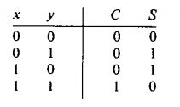
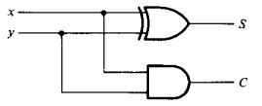

1-bit Half Adder
$S=xy^{′}+x^{′}y=x⨁y$
$C=xy$

Slide 12
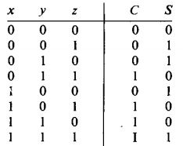
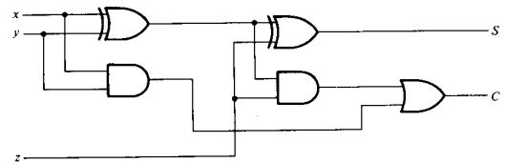



1-bit Full Adder
$S=x{′y}^{′}z+x^{′}yz^{′}+xy^{′}z^{′}+xyz$
$C=xy+xz+yz$
$$C_{out}$$
$$C_{in}$$

Slide 13
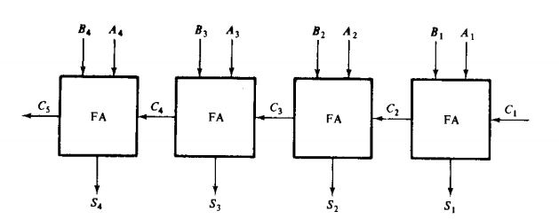
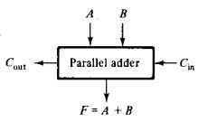

Parallel Adders
$n$ number of 1-bit full-adders are connected in cascade to form a $n$-bit parallel adder

Slide 14
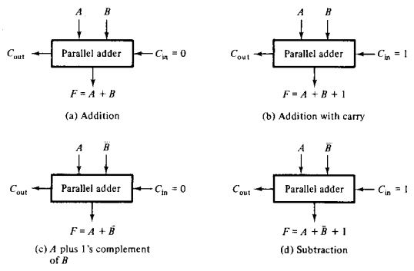
Arithmetic Operations by ALU

Slide 15
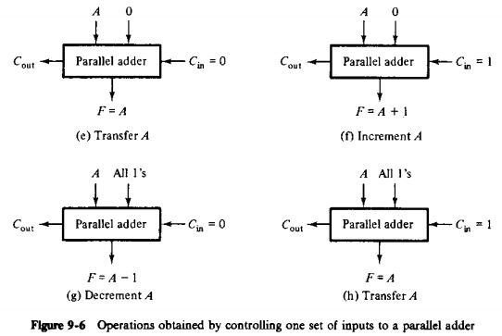
Arithmetic Operations by ALU

Slide 16
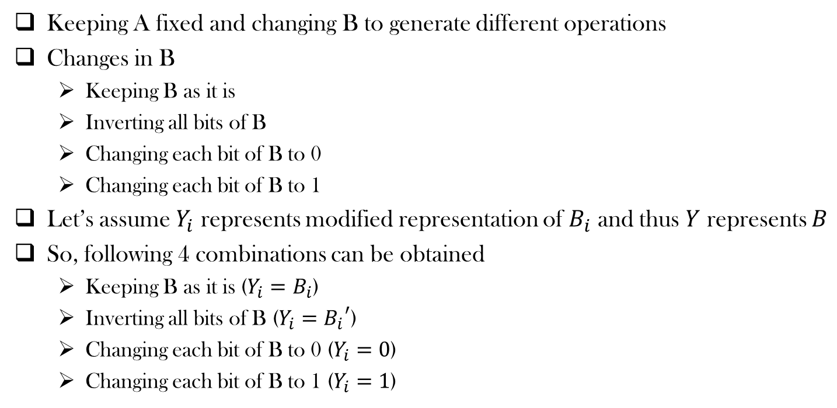
What are we doing?
Keeping A fixed and changing B to generate different operations
Changes in B
Keeping B as it is
Inverting all bits of B
Changing each bit of B to 0
Changing each bit of B to 1
Let’s assume $Y_{i}$ represents modified representation of $B_{i}$ and thus $Y$ represents $B$
So, following 4 combinations can be obtained
Keeping B as it is ($Y_{i}=B_{i}$)
Inverting all bits of B ($Y_{i}={B_{i}}^{′}$)
Changing each bit of B to 0 ($Y_{i}=0$)
Changing each bit of B to 1 ($Y_{i}=1$)

Slide 17
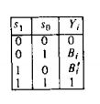
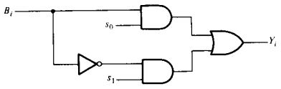





What are we doing?
So Following 4 combinations can be obtained
Keeping B as it is ($Y_{i}=B_{i}$)
Inverting all bits of B ($Y_{i}={B_{i}}^{′}$)
Changing each bit of B to 0 ($Y_{i}=0$)
Changing each bit of B to 1 ($Y_{i}=1$)
$Y_{i}=B_{i}s_{0}$ + ${B_{i}}^{′}s_{1}$

Slide 18
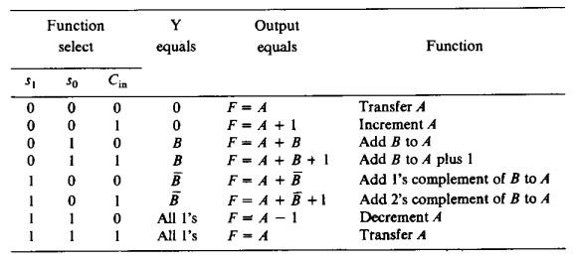

Function Table
Modified $B$

Slide 19
Function Table: Designer’s perspective
Modified $B$

Slide 20

Function Table
Modified $B$

Slide 21
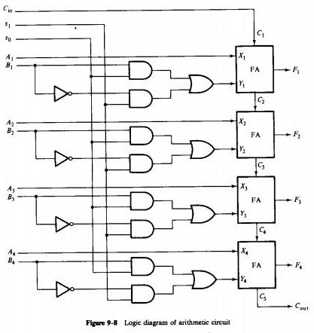






Logic Diagram of an independent Arithmetic Circuit
Selection Variables
…
Combinational Circuit
$$C_{in}$$
$n−bit$ Parallel adder
$$A$$
$$X$$
$$B$$
$$Y$$

Slide 22



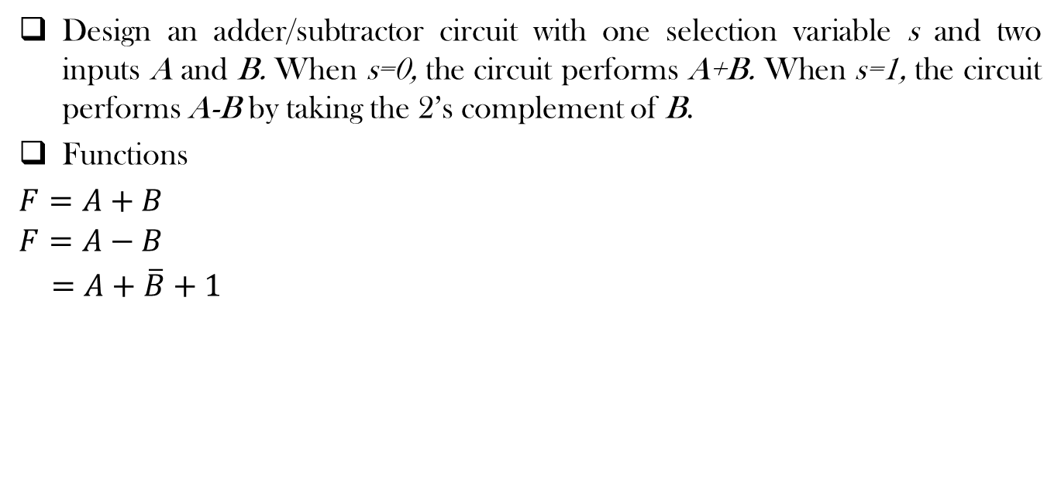

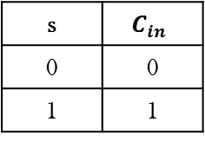



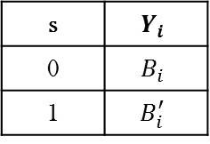
Design Example
Design an adder/subtractor circuit with one selection variable s and two inputs A and B. When s=0, the circuit performs A+B. When s=1, the circuit performs A-B by taking the 2’s complement of B.
Functions
$F=A+B$
$$F=A−B$$
$=A+\overline{B}+1$
Selection Variables
…
Combinational Circuit
$$C_{in}$$
$n−bit$ Parallel adder
$$A$$
$$X$$
s | $$Y_{i}$$
0 | $$B_{i}$$
1 | $$B_{i}^{′}$$
s | $$C_{in}$$
0 | 0
1 | 1
$$B$$
$$Y$$
$$Y_{i}=s^{′}B_{i}+sB_{i}^{′}=s⨁B_{i}$$
$$C_{in}=s$$

Slide 23
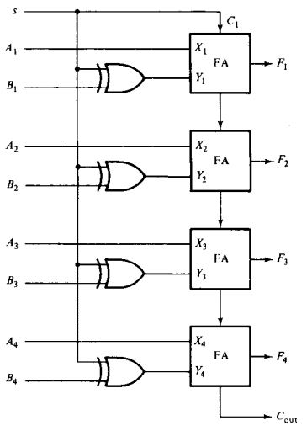
Design Example

Slide 24
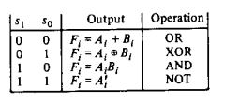
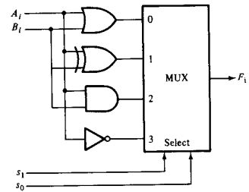
Designing a Logic Circuit
We shall implement three basic logical operations (AND, OR and NOT) and an XOR operation

Slide 25
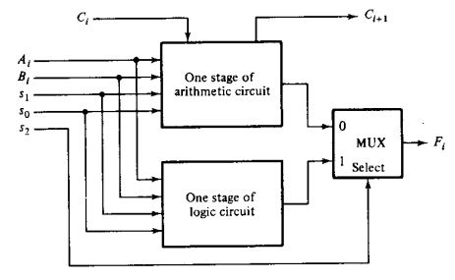
Designing a Logic Circuit
Let’s combine it with arithmetic operations

Slide 26
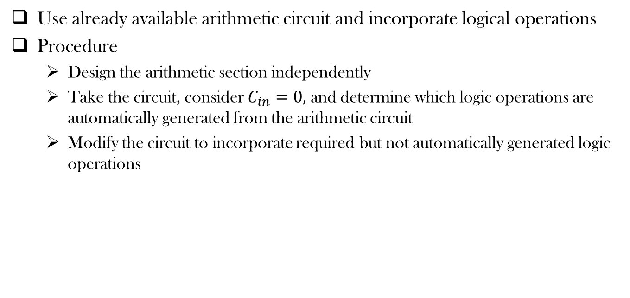
More Efficient Design
Use already available arithmetic circuit and incorporate logical operations
Procedure
Design the arithmetic section independently
Take the circuit, consider $C_{in}=0,$and determine which logic operations are automatically generated from the arithmetic circuit
Modify the circuit to incorporate required but not automatically generated logic operations

Slide 27
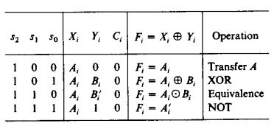
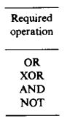
More Efficient Design
Use already available arithmetic circuit and incorporate logical operations

Slide 28
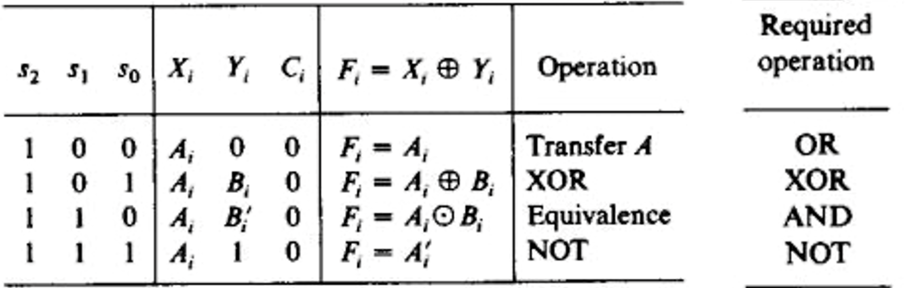
More Efficient Design
Use already available arithmetic circuit and incorporate logical operations

Slide 29
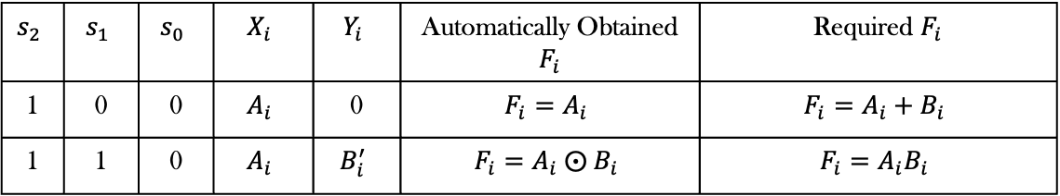
Incorporating remaining functions
Unresolved cases
$$s_{2}$$ | $$s_{1}$$ | $$s_{0}$$ | $$X_{i}$$ | $$Y_{i}$$ | Automatically Obtained $F_{i}$ | Required $F_{i}$
1 | 0 | 0 | $$A_{i}$$ | 0 | $$F_{i}=A_{i}$$ | $$F_{i}=A_{i}+B_{i}$$
1 | 1 | 0 | $$A_{i}$$ | $$B_{i}^{′}$$ | $$F_{i}=A_{i} ⨀{ B}_{i}$$ | $$F_{i}=A_{i}B_{i}$$

Slide 30
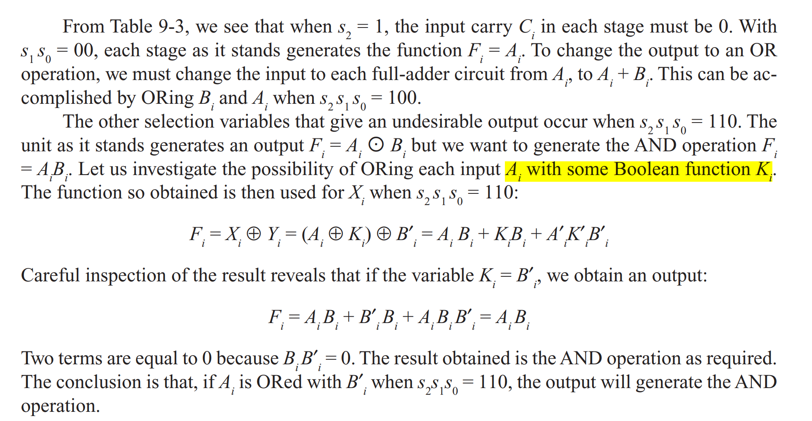
Incorporating remaining functions
(A + K)

Slide 31
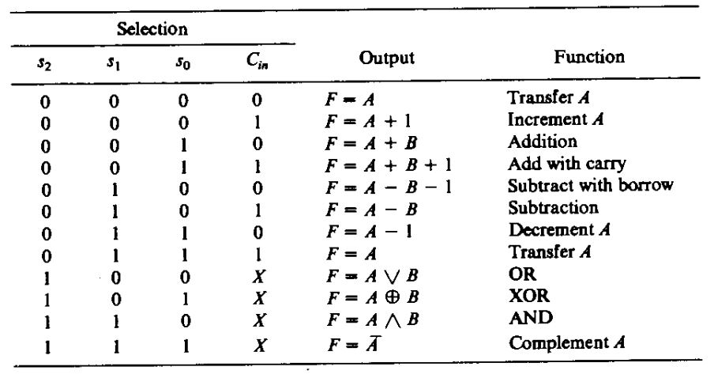

Final Boolean Functions
Combining the arithmetic and logical cases, we get the final form of the Boolean function as:
$$X_{i}=A_{i}+s_{2}s_{1}^{′}s_{0}^{′}B_{i}+s_{2}s_{1}s_{0}^{′}B_{i}^{′}$$
$$Y_{i}=s_{0}B_{i}+s_{1}B_{i}^{′}$$
$$Z_{i}=s_{2}^{′}C_{i}$$
where C₁ = C_{in}

Slide 32
Let’s See Another Example
Derive the input equations (Xi, Yi and Zi) for the parallel adders to be used in the ALU which satisfies the following functional design specification.
s₂ | s₁ | c_{in} | Required Functions
0 | 0 | 0 | F = AB + C
0 | 0 | 1 | F = AB + C + 1
0 | 1 | 0 | F = AB
0 | 1 | 1 | F = AB + 1
1 | 0 | x | F = (AB)’
1 | 1 | x | F = AB

Slide 33
Solution
s₂ | s₁ | c_{in} | X | Y | Z | Required Functions
0 | 0 | 0 | AB | C | 0 | F= AB + C
0 | 0 | 1 | AB | C | 1 | F = AB + C +1
0 | 1 | 0 | AB | 0 | 0 | F = AB
0 | 1 | 1 | AB | 0 | 1 | F = AB + 1
1 | 0 | x |  |  |  | F = (AB)’
1 | 1 | x |  |  |  | F = AB

Slide 34
Solution
X = AB
Y = s₁’ C
Z = c_{i}
where c₁ = c_{in}

Slide 35
Solution
s₂ | s₁ | c_{in} | X | Y | Z | Required Functions
0 | 0 | 0 | AB | C | 0 | F= AB + C
0 | 0 | 1 | AB | C | 1 | F = AB + C +1
0 | 1 | 0 | AB | 0 | 0 | F = AB
0 | 1 | 1 | AB | 0 | 1 | F = AB + 1
1 | 0 | x | AB | 1 | x | F = (AB)’
1 | 1 | x | AB | 0 | x | F = AB

Slide 36
Solution
X = AB
Y = s₁’ C
Z = c_{i}
where c₁ = c_{in}
Then for logical operations,
X = AB
Y = s₁’ C + s₂ s₁’
Z = s₂’ c_{i}

Slide 37
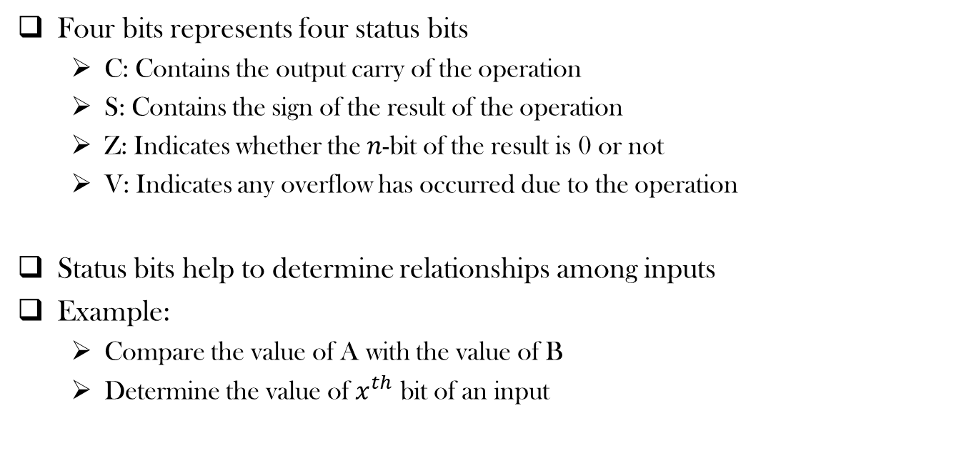
Status Register
Four bits represents four status bits
C: Contains the output carry of the operation
S: Contains the sign of the result of the operation
Z: Indicates whether the $n$-bit of the result is 0 or not
V: Indicates any overflow has occurred due to the operation
Status bits help to determine relationships among inputs
Example:
Compare the value of A with the value of B
Determine the value of $x^{th}$ bit of an input

Slide 38
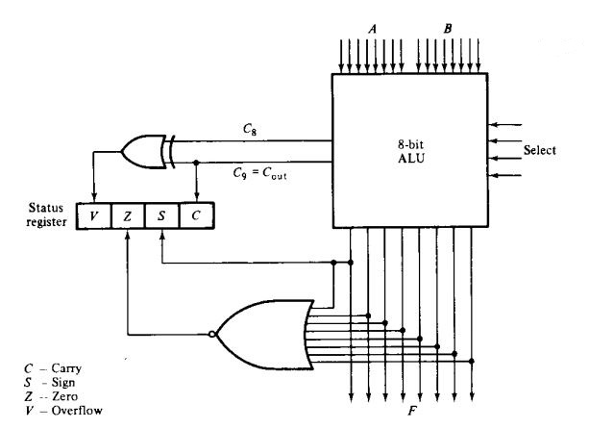
Status Register

Slide 39
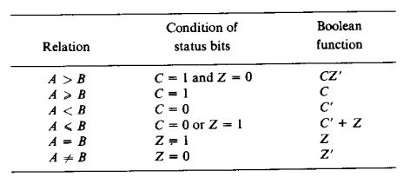

Comparing two unsigned numbers
Compare the value of A with the value of B
Check the status bits (mainly C and Z) after the performing the following operation
$F\text{= }\text{A}\text{ + }\text{B}\text{’ + 1}=A−B$
$$=2^{n}+(A−B)$$

Slide 40
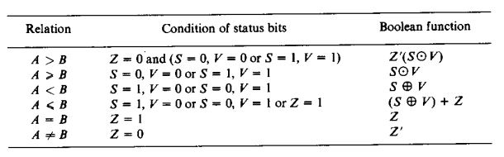

Comparing two signed numbers
Compare the value of A with the value of B
Check the status bits (mainly Z, V and S) after the performing the following operation
$$F=A−B$$

Slide 41
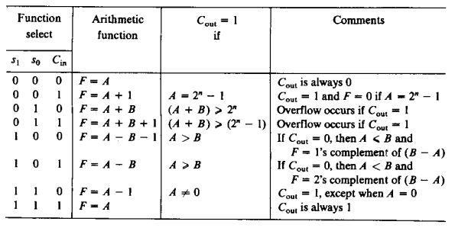
Effect of Output Carry

Slide 42
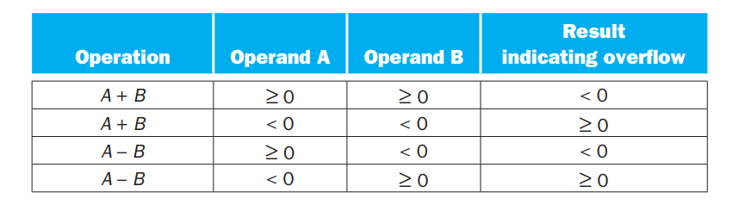
Overflow Flag

Slide 43
References
Digital Logic and Computer Design by M. Morris Mano
Chapter 9 (9.1-9.7)

Slide 44
Thank You ☺

